Slide 1
Summary
Problem/Hypothesis
How
High-level conclusion

Slide 2
Background
Other studies on gentrification
Stage Theory
People, Policy, Place
Model neighborhoods

Slide 3
Emmy
What is our model?
Weighted
Ranking

Slide 4
Emmy
How did we choose variables
Income
Sales
Development
Crime
Opp Zone

Slide 5




Michana
Data Exploration
Crime >> NYPD
Challenges :
- Not enough reliable data
- No available precinct mapping
Development >> NY State
Challenges :
- Only current year data availab;e
Sales >> NYC Department of Finance
Challenges :
- Unexpected data types
- Errors while merging dataframes
Income >> IRS
Challenges :
- Inconsistent data structures
- Dealing with several data files

Slide 6
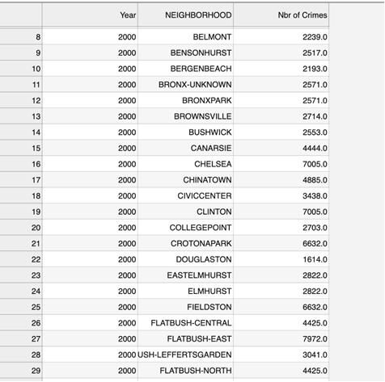
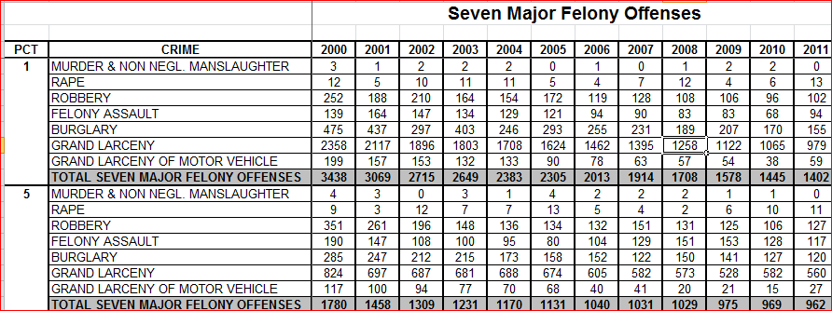
CRIME data
CRIME DATA CLEANUP
Original Raw Crime Data by Precinct
Final Cleaned and stacked Crime Data by Neighborhood

Slide 7
Sales and Dev - Emmy
Data Clean Up
Before and After
Tell the transformation story

Slide 8
JC - Income
Data Clean Up
Before and After
Tell the transformation story

Slide 9
???
Coding for Model

Slide 10
All
Dashboard

Slide 11
All – but one slide
Hypothesis
Conclusion

Slide 12
JC
Limitations
Recommendations

Slide 13
Q&A

